Slide 1
Attorney Authorization for Release of Information
For Mass Legal Services and Boston Housing Authority in partnership with the Document Assembly Line Project
Kayla Gallagher
Notes:
with Joelle and Mike Carroll

Slide 2
What is an Information Release?
Notes:
* provides access to private individuals infomration - such as records
* Mass Legal - will provide organization, atty, assistants, law students access to records regarding their legal matter
* BHA allows for all previous BHA records but also CORI (Criminal Offender Record Info), including dismissed and not guilty cases.

Slide 3
Stakeholders & Users:
Client/Applicant
Boston Housing Authority
Attorney
Notes:
* A client facing solution where the main goal it to assist those seeking legal services to fill out the necessary required forms to receive the best and most efficient help in a timely manner
* will also benefit the Boston Housing Authority and any attorney working with the clients to make the process flow easier

Slide 4
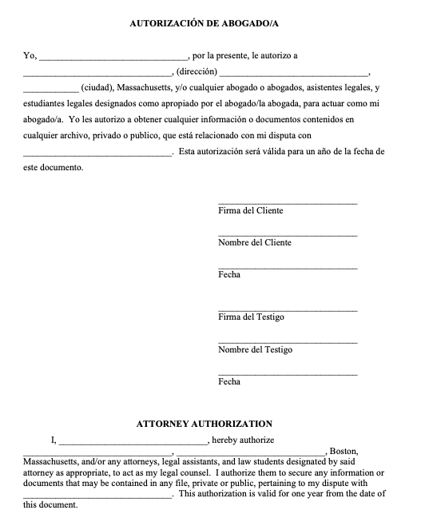
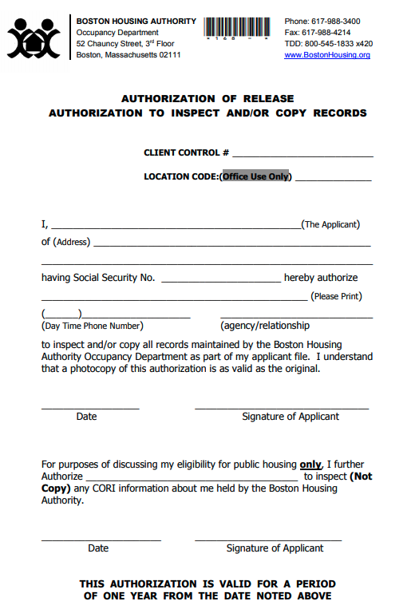
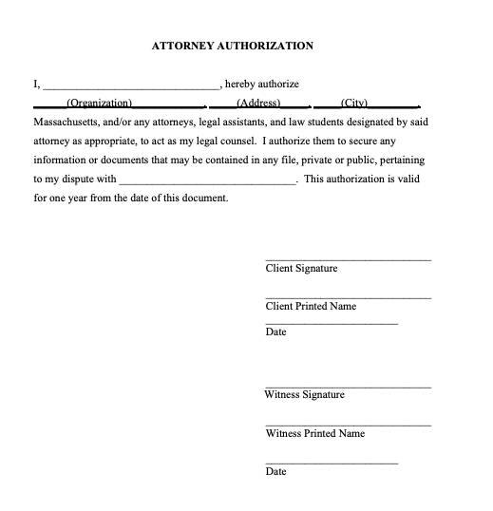
Currently
Masslegalservices.org
Bostonhousing.org
Notes:
* Mass legal services provides a word document on their website, lacks any direction and requires a witness signature.
* Boston Housing is on the site as a non-fillable PDF to print and fill out and send to the occupancy department OR it is included on page 30/31 of the paper housing application.
* Both sites are not easy to navigate and to avoid sorting through links and indexing the entire site, It was easiest to find through a direct google search.

Slide 5
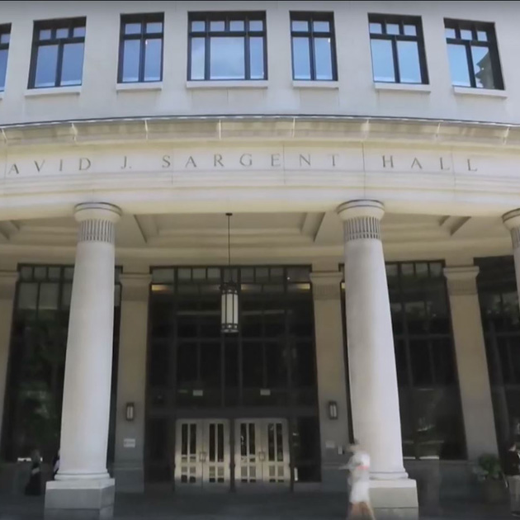

Document Assembly Line Project
Photos courtesy of SuffolkLitLab.org and Suffolk.edu
Notes:
As you may know, Doc Assembly Line Project is a collaborative volunteer group based out of Suffolk's LIT Lab with the goal to produce mobile friendly online forms in multiple languages in partnership with Mass A2J
* evolving solution to the many new obstacles COVID has brought us this year
* A2J goal is to achieve equal justice for ALL persons of the commonwealth

Slide 6
Notes:
Our Solution is in two parts - The first for the Mass Legal Services Attorney Autorization form.
We propose a user friendly interview that will translate into a word ducment with added context to instruct how to be filled out in both english and spanish.
Boston Panning and development Agency (Feb 2019) stated 200k+ adults in Massachusetts self-classify as Limiited English Speaking with spanish as their first language (almost 40%) of limited english speaking adults
having this interview in both english and spanish ensures that we're not leaving behind an entire population seeking legal help

Slide 7
Notes:
Second Part would be an interview to specifcially fill out the BHA Release Authorization.
As Chauncy Street is closed to walk-ins for covid the option is to fill out and mail the form. Our interview would be easy to find and use and provide next step insturctions to minimize delay as incomplete applications are not considered.
HUD describes 42% of heads of households in the boston Housing authority to be over 62 and making this form easy to find and be completed will allow for an approachable solution for those who may be less familiar or trusting of technology.

Slide 8
Thank You!
Notes:
with Joelle and Mike Carroll

